Slide 1
Seminar-2 Document Management System Android Application
Deepak Jain and Krish Ambre 10.07.2019

Slide 2

Overview
Of
Project
Purpose
To digitalize the present system of document management.
Features
User Management
Document Upload
Document Search
Document Download
Problems Encountered
None

Slide 3
What is
Document Management System ?

Slide 4
Why is DMS needed?
Documents available at Fingertips
Allows employees to improve quality of service to customers by giving them access to the relevant information quickly
Reduces Response Time
No Risk of losing Documents

Slide 5

Plan of Action

Slide 6
Working
The administrator can add or remove users and employees can Sign in in the app via email
Options like ‘Upload Document’, ‘View Document’, ‘Search Documents’ and ‘Add user’
Miscellaneous features like ‘Change Password’ and ‘Forgot Password’

Slide 7
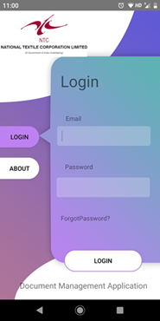
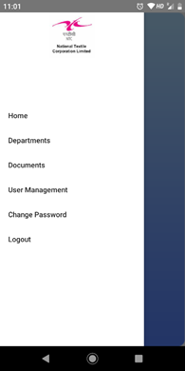
Layout

Slide 8
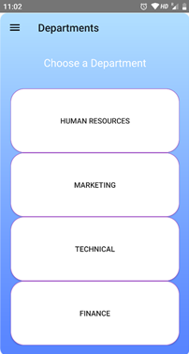
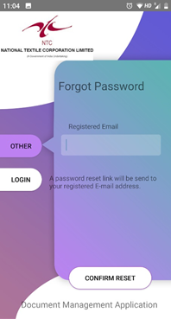
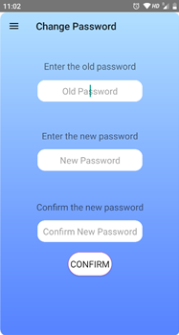
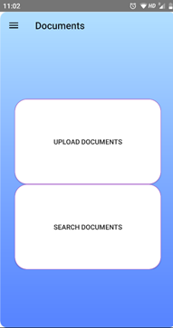

Slide 9
Commencement of Practice School-1 in Podar Mills and begin understanding the workflow.
Developed the basic structure and UI of the app.
The final version ready is ready
21.05.19
28.05.19
14.06.19
30.06.19
10.07.19
Understood the workflow and project was started..
Integrate the firebase backend completely.

Slide 10





Technical Specifications
Github
Android Studio
Firebase
Java

Slide 11
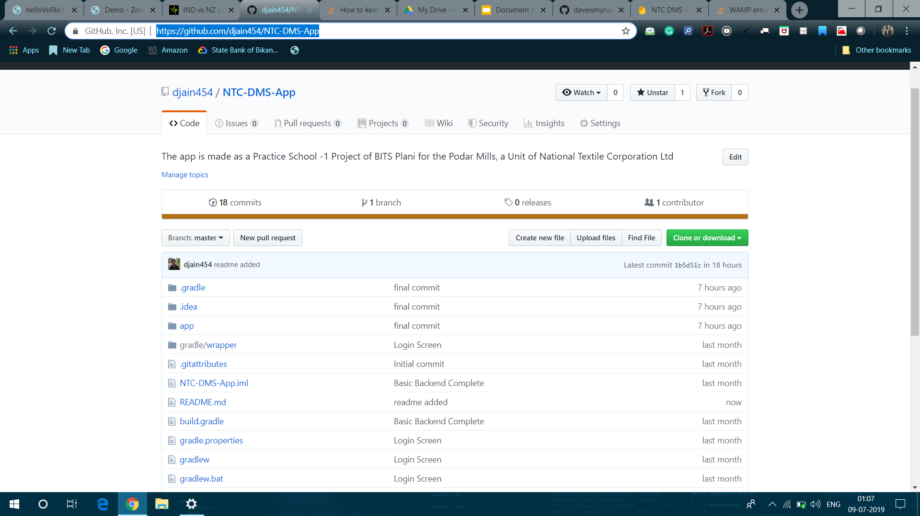

Slide 12
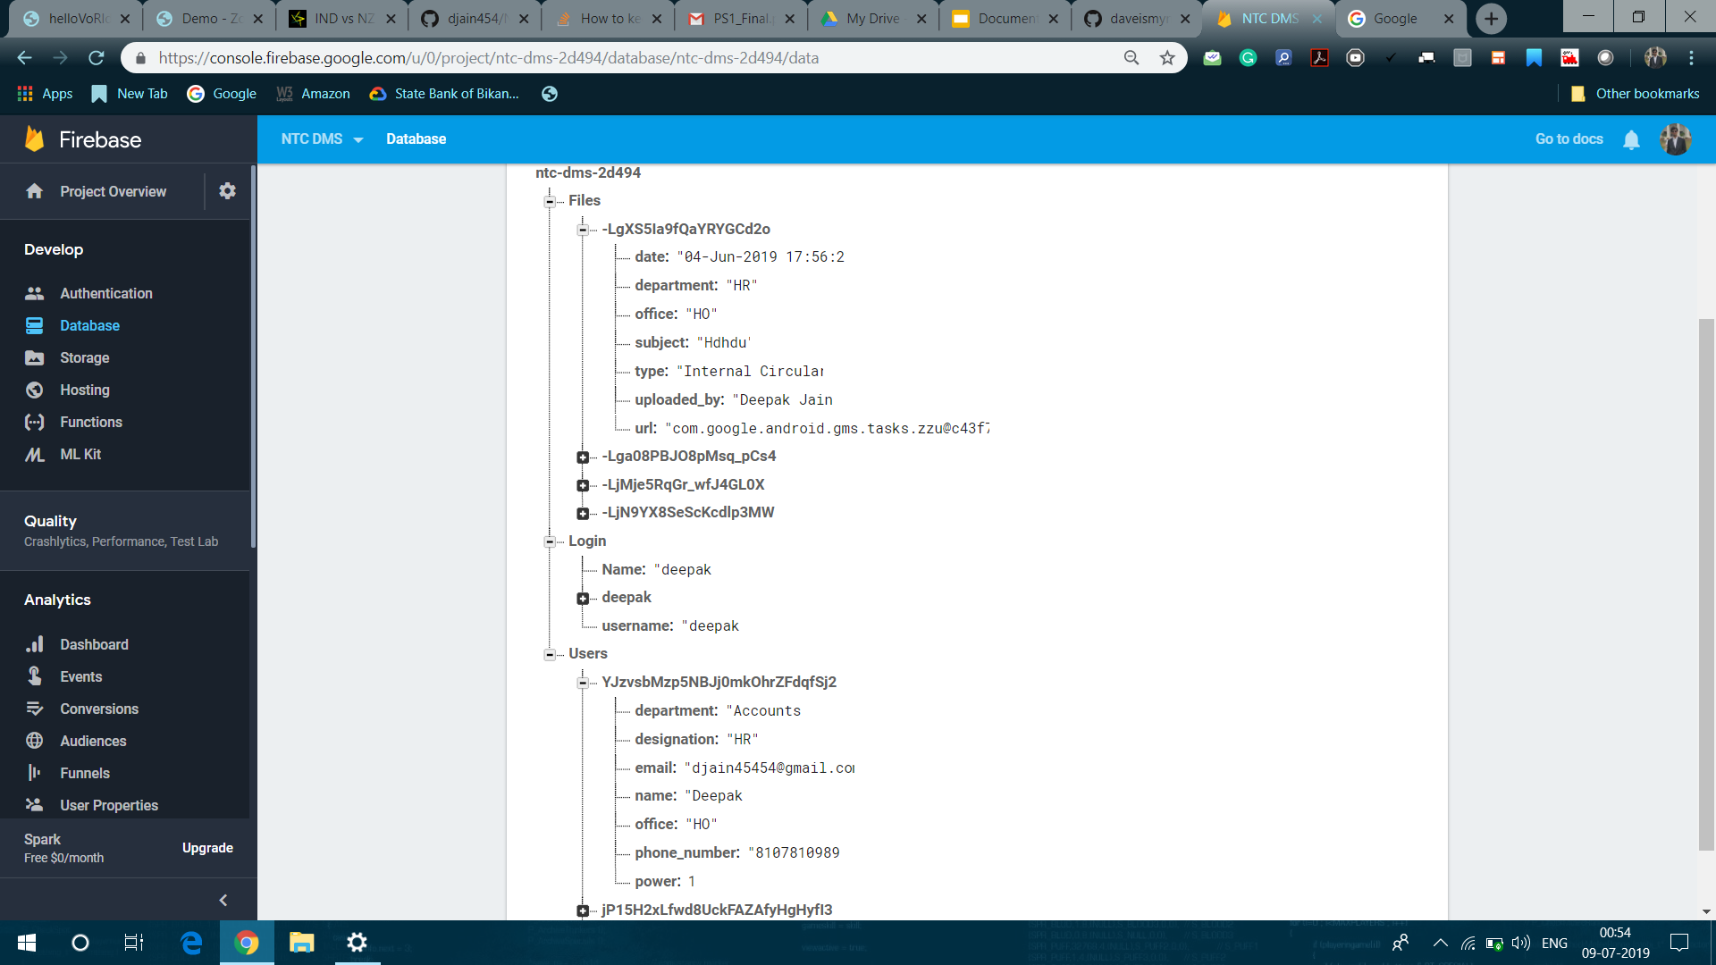

Slide 13
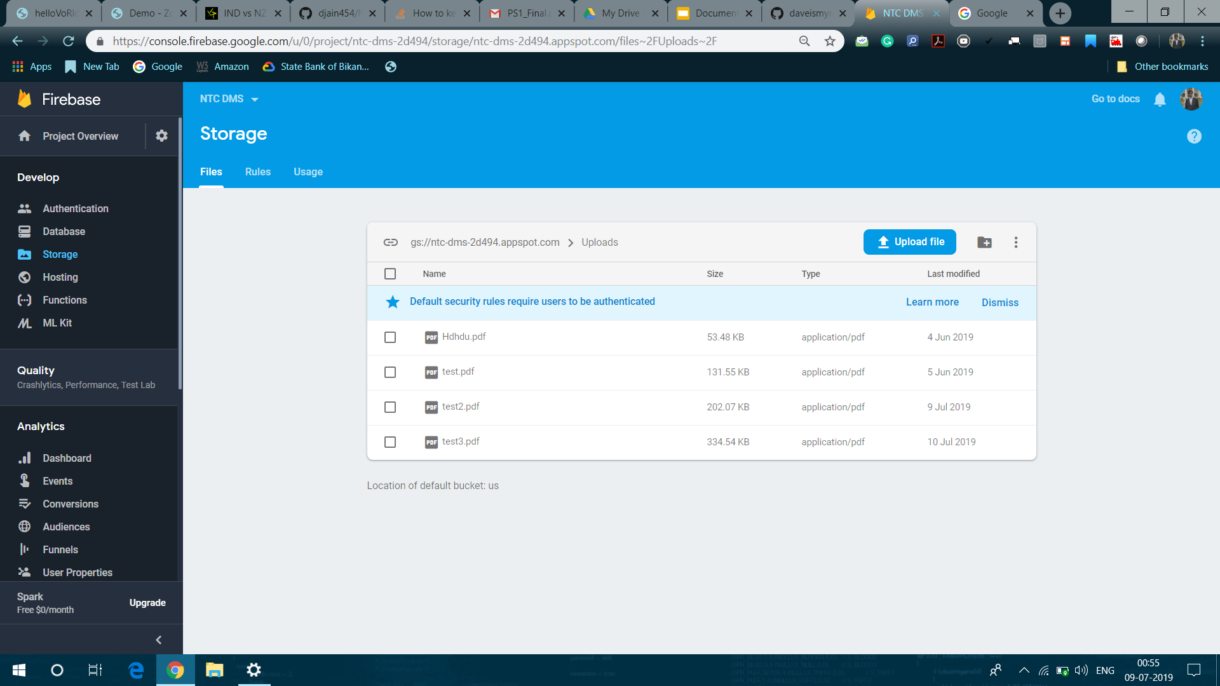

Slide 14
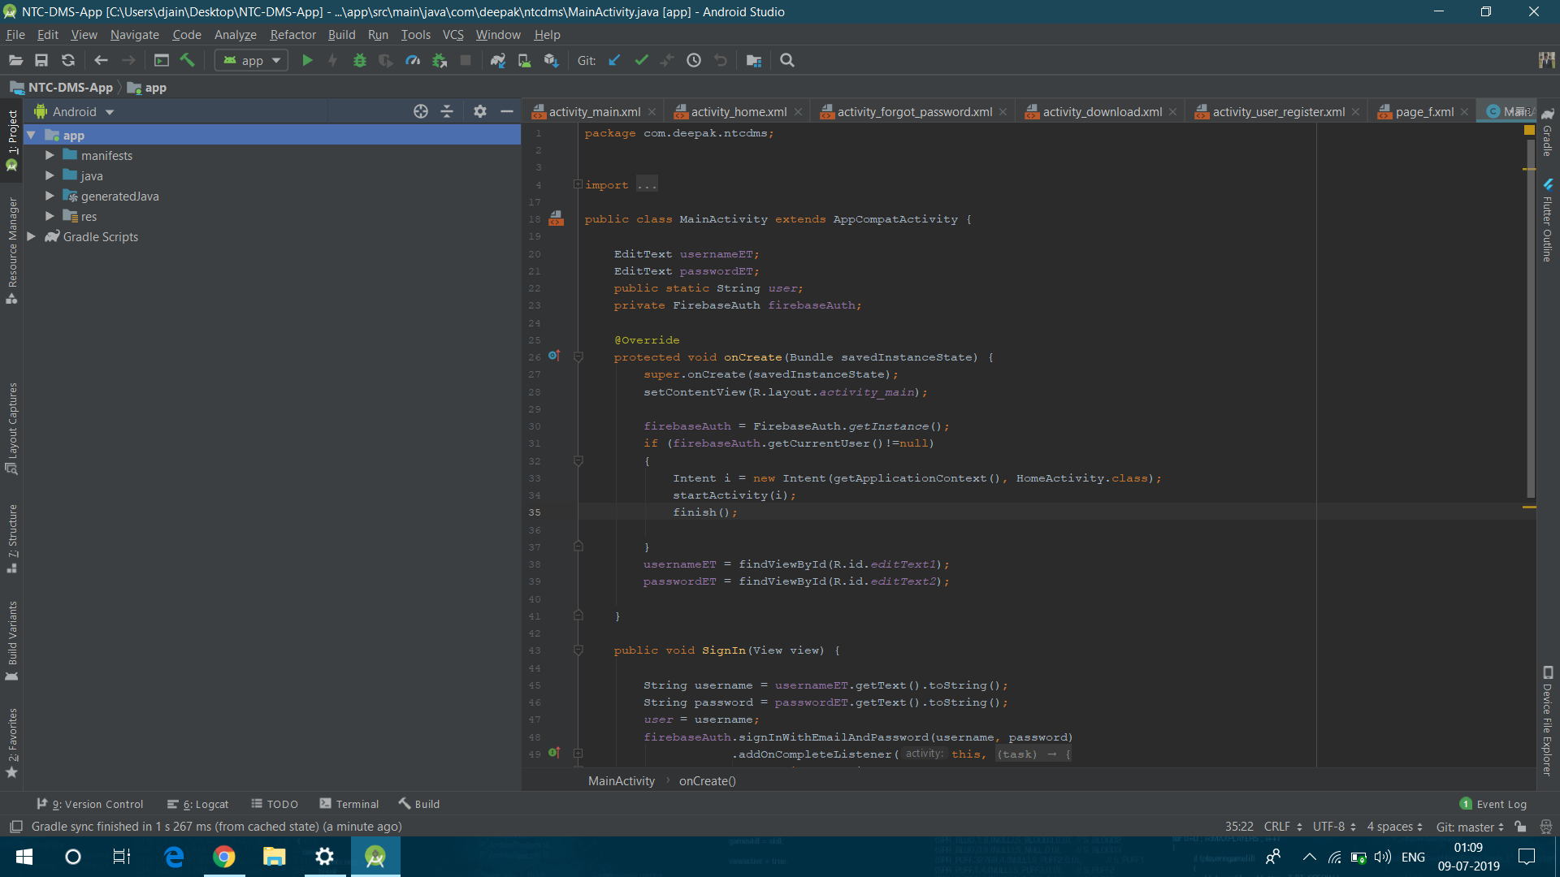

Slide 15
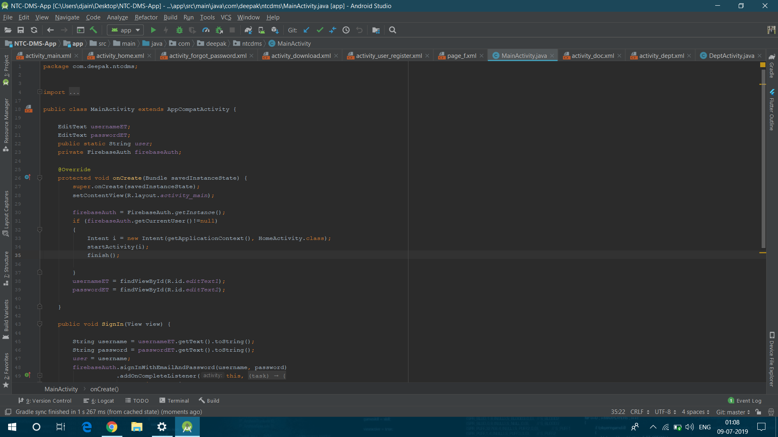

Slide 16
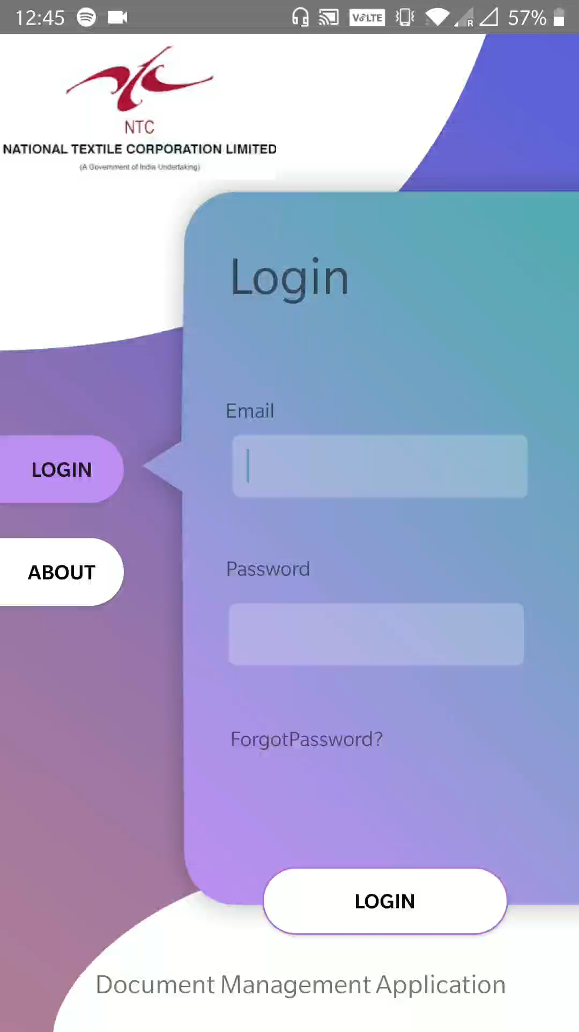
Demonstration
Employee need to login with his/her credentials
To upload a document, employee need to go to respective tab and select the appropriate details.
Once a user upload document, it can be access by other users and the user can download the documents.
To ease the process of finding documents there is search functionality which can search by name or department.

Slide 17

Learning Outcomes
Android App Development
Learn how to make an android app
Working of Organization
Learn how organization works in real life
Soft Skills
Developed communication and Presentation Skills

Slide 18
References
https://github.com/djain454/NTC-DMS-App

Slide 19
Thank You
We are open to Questions

